Slide 1


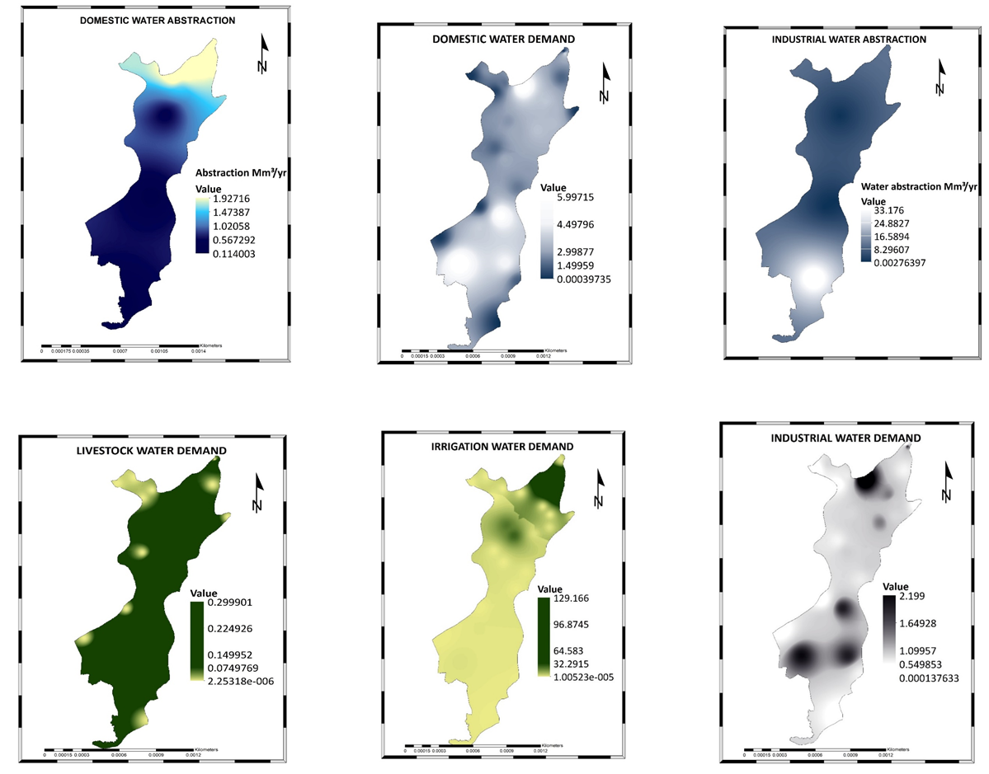
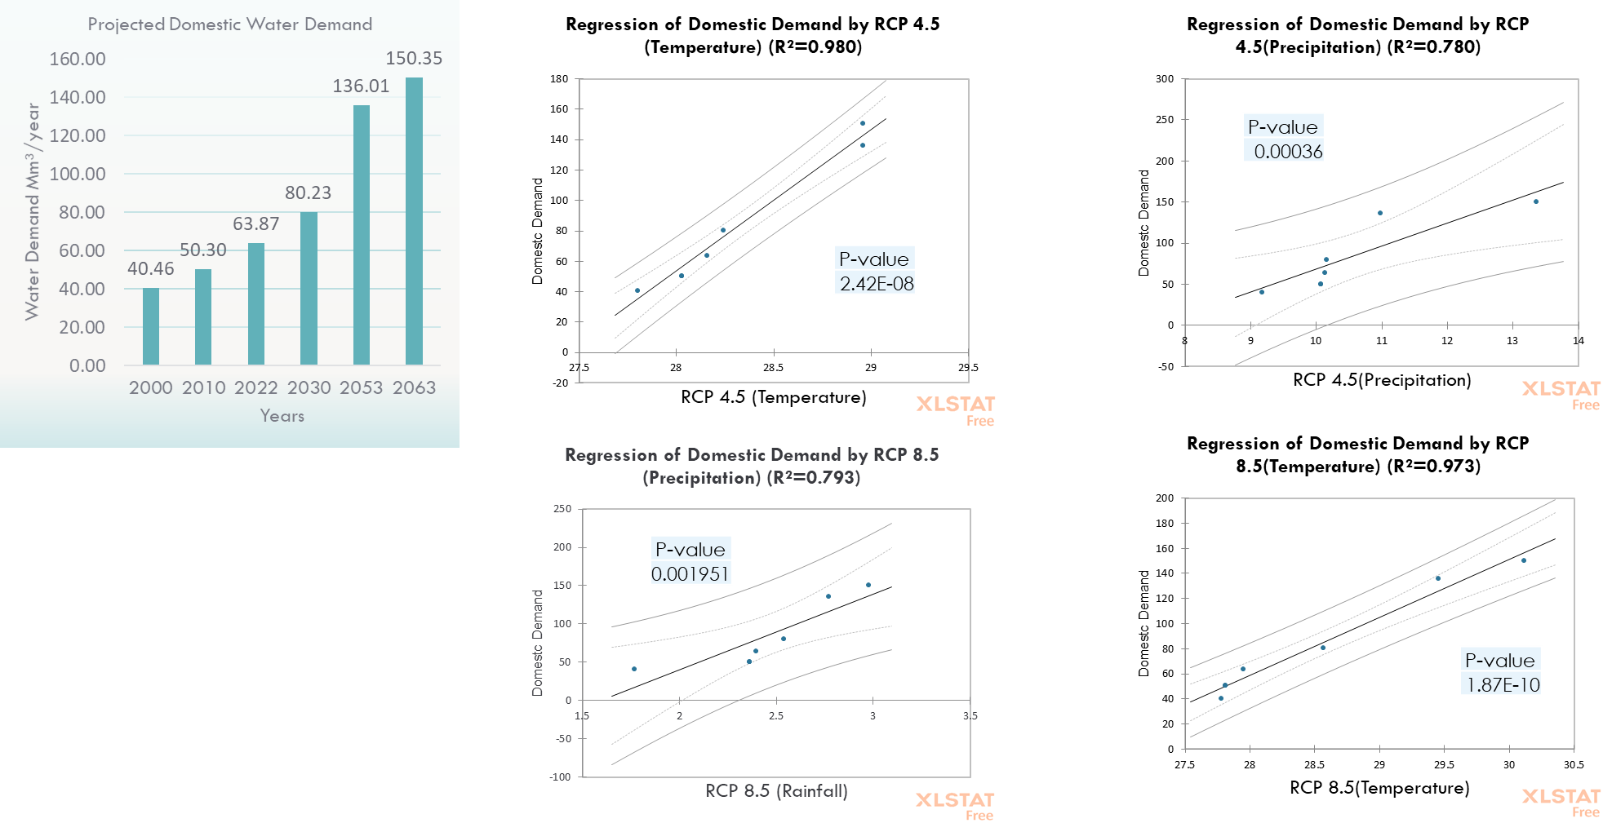
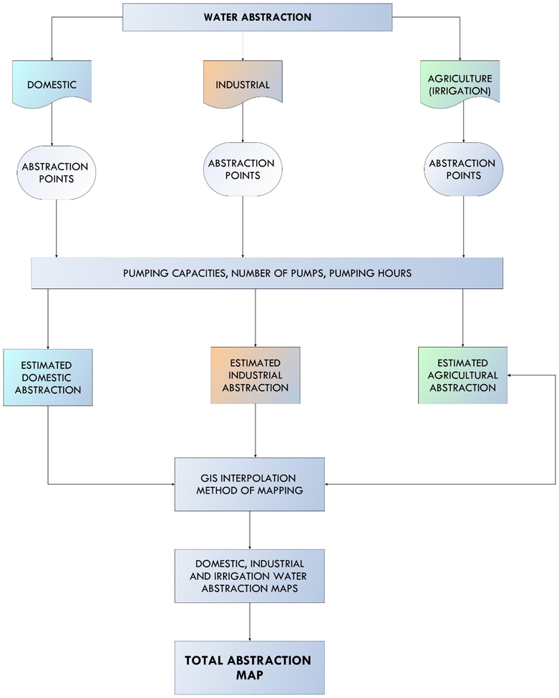
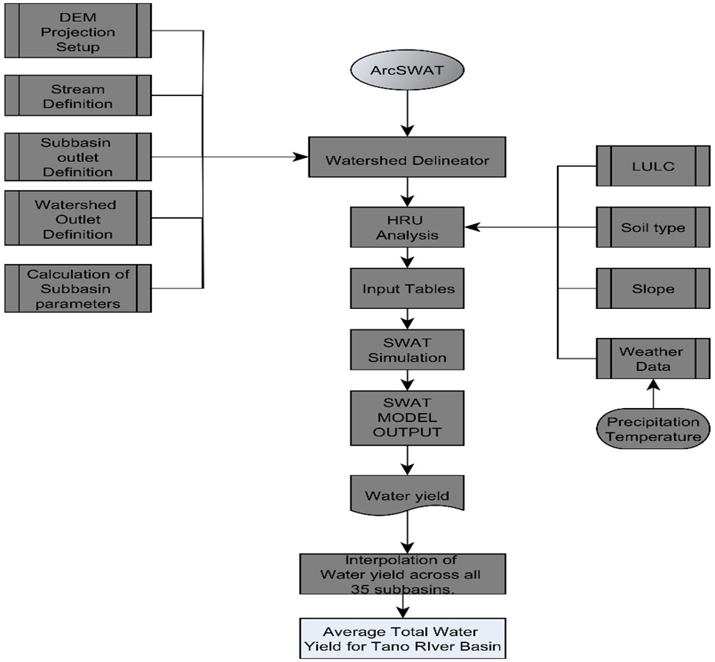
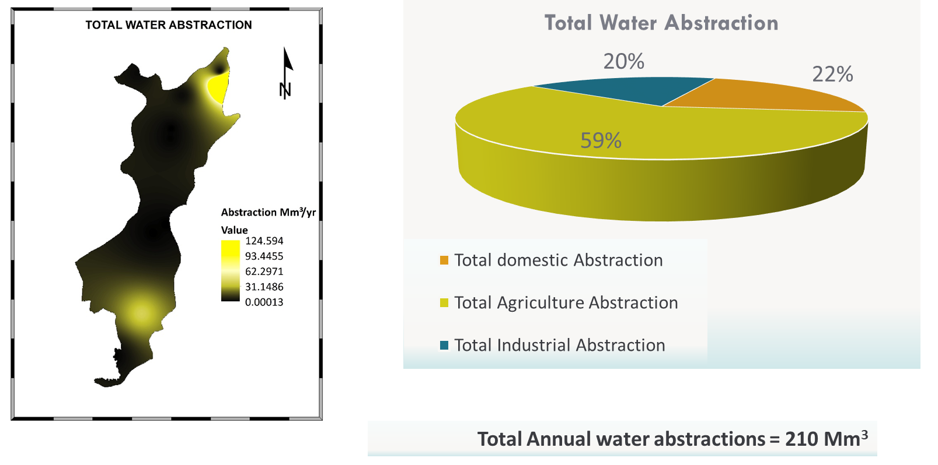
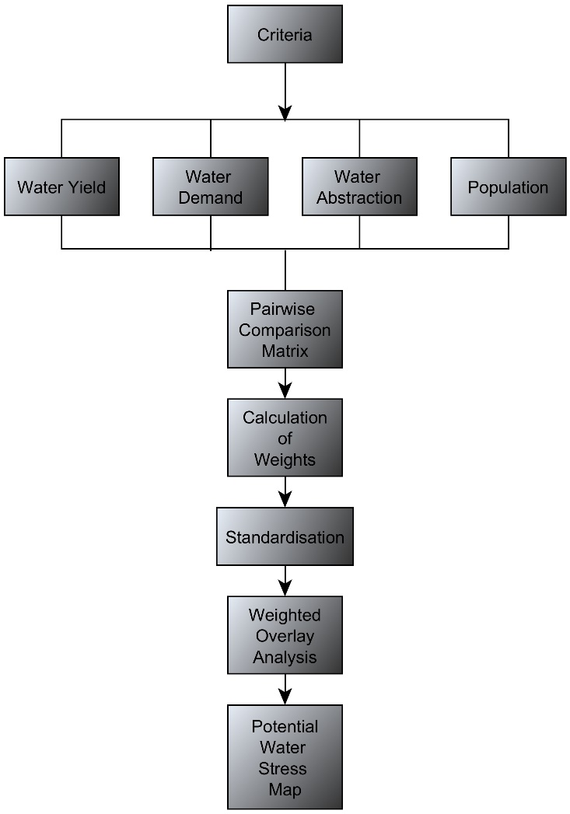
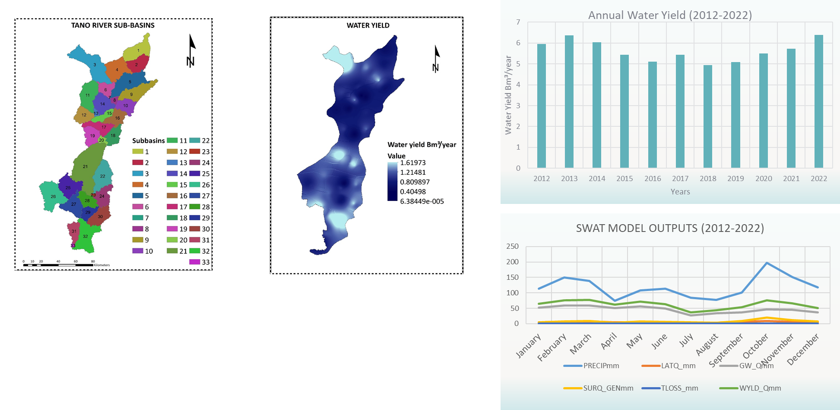

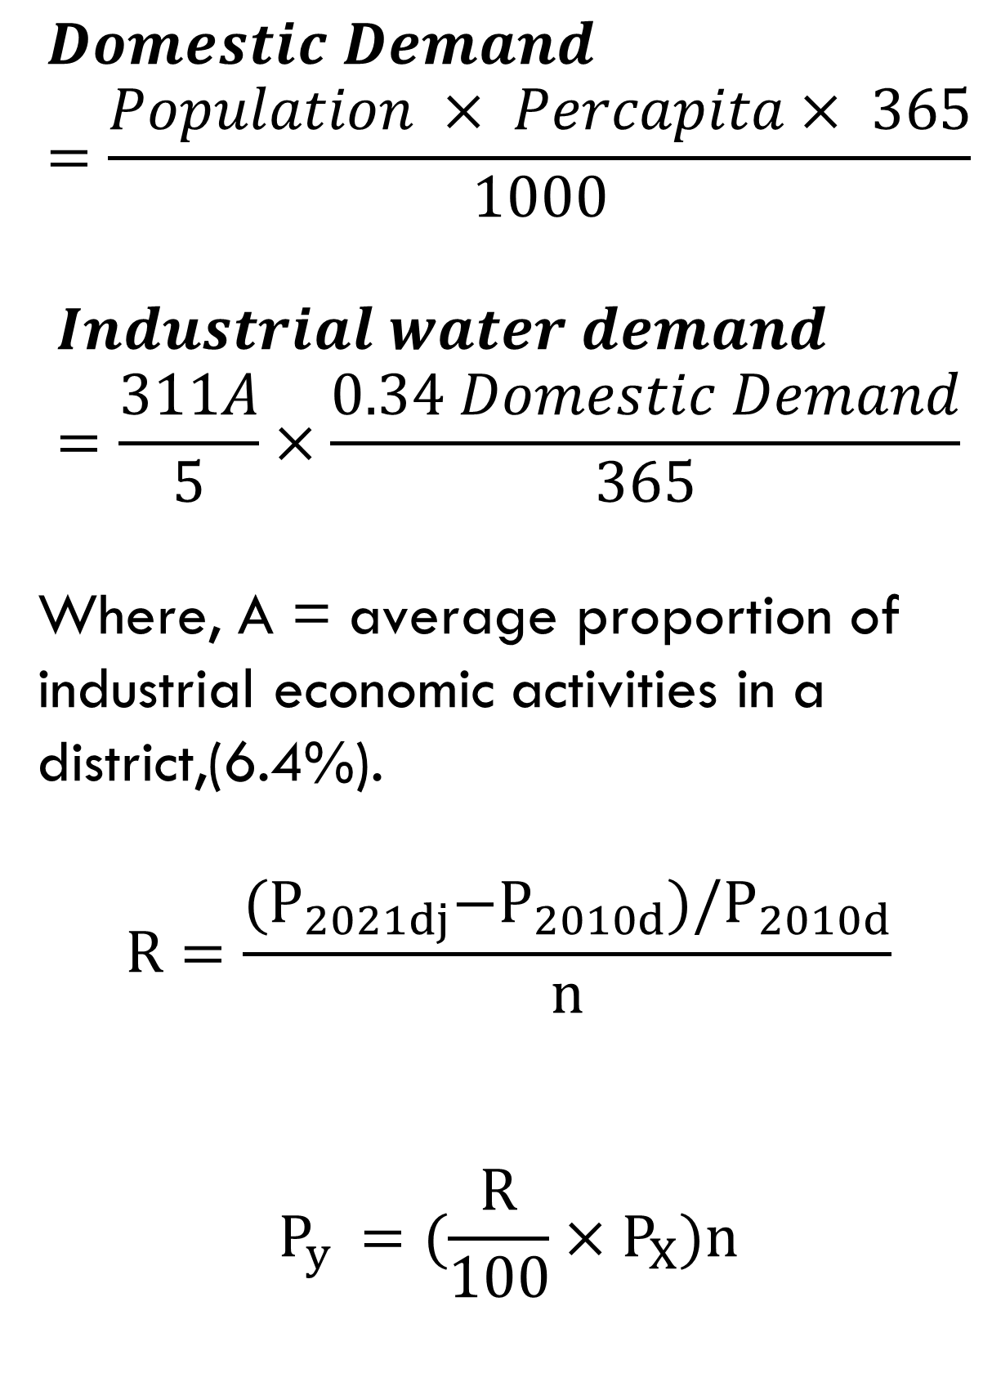
GEOSPATIAL MAPPING AND ANALYSIS OF WATER DEMAND,ABSTRACTION AND WATER YIELD OF THE TANO RIVER BASIN,GHANA
Bernard Michael Akwasi Poku Otchere, Eric Ofosu-Antwi, Martin Domfeh, Evelyn Twumasiwaa Arthur, Ransford Wusah-Bakuri, Amoah Theophilus, Saeed Ibn Idris Kofi Yeboah, Anna Amankwah Minkah, Samuel Akowuah Okyere, Romeo Tweneboah Koduah
INTRODUCTION
RESULTS/DISCUSSION
RESULTS/DISCUSSION
In Ghana, River basins are critical sources of water for various competing users
The Tano River Basin is one of the most exploited and water stressed basins in Ghana (WRC,2017).
OBJECTIVE
To comprehensively assess and geospatially analyze surface water dynamics, including demand, consumption, withdrawal, and availability in the Tano River Basin of Ghana (TRB).
METHODS
CONCLUSIONS
The total water abstraction and demand (domestic, industrial and agriculture uses) for the current year were estimated as 210 Mm3 and 269 Mm3 respectively.
Projected domestic water demand is set to increase: 80.23 million cubic meters by 2030, 136.01 million cubic meters by 2053, and 150.35 million cubic meters by 2063.
Temperature will significantly influence domestic water demand in 2030, 2053, and 2063, under both RCP 4.5 and RCP 8.5 scenario.
SWAT model estimated 5 billion cubic meters/year water yield across 33 sub-basins in Tano River Basin, with R² values of 0.65 (calibration) and 0.60 (validation).
Water stress assessment shows 42% "Moderate Stress," 40% "High Stress," 4% "Very Low Stress," and 15% "Low Stress."
$$Domestic Demand=\frac{Population × Percapita× 365}{1000}$$
$$Industrial water demand=\frac{311A}{5}×\frac{0.34 Domestic Demand}{365}$$
Where, A = average proportion of industrial economic activities in a district,(6.4%).
$$R=\frac{{(P}_{2021dj}−P_{2010d})/P_{2010d}}{n}$$
$$P_{y }=(\frac{R}{100}×P_{X})n$$

